Slide 1
Welcome to
Interdisc. Computer Sci II

Slide 2

What We’ll Be Talking About Today
Discuss Class Format
Grading Scheme
Key Objectives
Deliverables
Tools
Small Java Intro

Slide 3
Three Classes a Week

Slide 4
Three Classes a Week
Classes with three parts

Slide 5
Three Classes a Week
Classes with three parts
Lecture with optional online Comprehension Quiz

Slide 6
Three Classes a Week
Classes with three parts
Lecture with optional online Comprehension Quiz
Live Coding Session (Most of the Time)

Slide 7
Three Classes a Week
Classes with three parts
Lecture with optional online Comprehension Quiz
Live Coding Session (Most of the Time)
Quick Lab (Attendance)

Slide 8
Three Classes a Week
Classes with three parts
Lecture with optional online Comprehension Quiz
Live Coding Session (Most of the Time)
Quick Lab (Attendance)
Full Lab

Slide 9
Grading Scheme
4 Major Assignments (50%)
4 Exams (30%)
10% Each
Final Which is Optional
Worst grade dropped
Attendance (4 Excused) (10%)
Comprehension Quizzes / Assignments (10%)

Slide 10
Key Objectives
Java Language
Object Oriented Programming
Light Data Structures and Algorithms
Quite Advanced Java
Interview Prep

Slide 11
Deliverables

Slide 12
Deliverables
Assignments

Slide 13
Deliverables
Assignments
Daily(Class Days) Labs

Slide 14
Deliverables
Assignments
Daily(Class Days) Labs
Comprehension Quizzes / Assignments
Delivered Via Git and GitHub or Moodle dropboxes

Slide 15
Tools

Slide 16
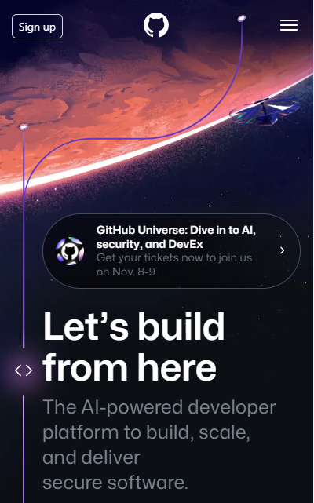
Tools

Slide 17
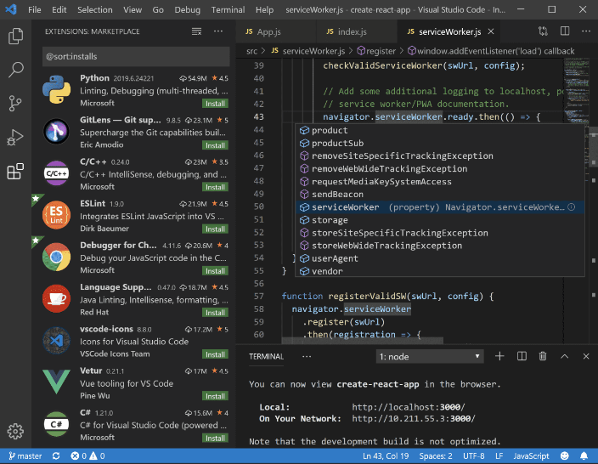
Tools

Slide 18
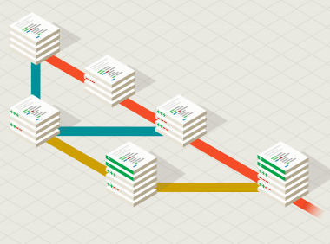

Tools

Slide 19
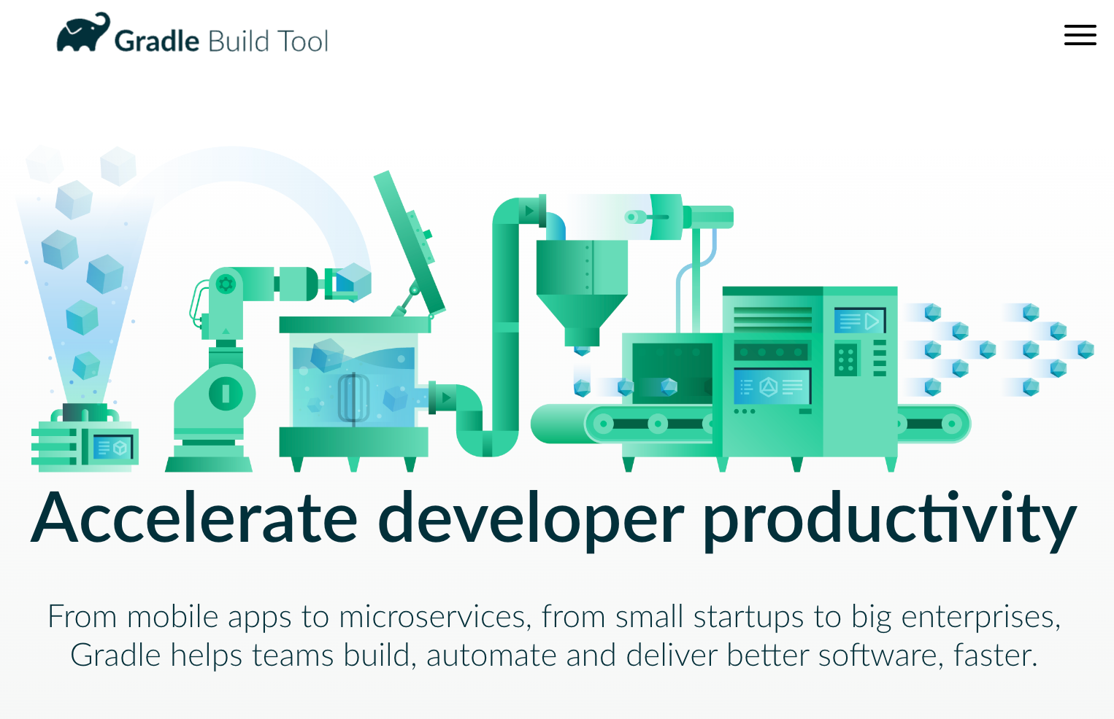
Tools

Slide 20
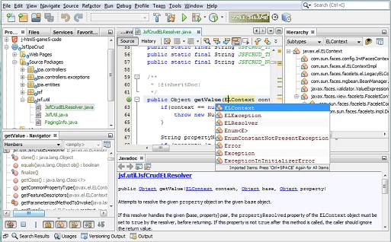
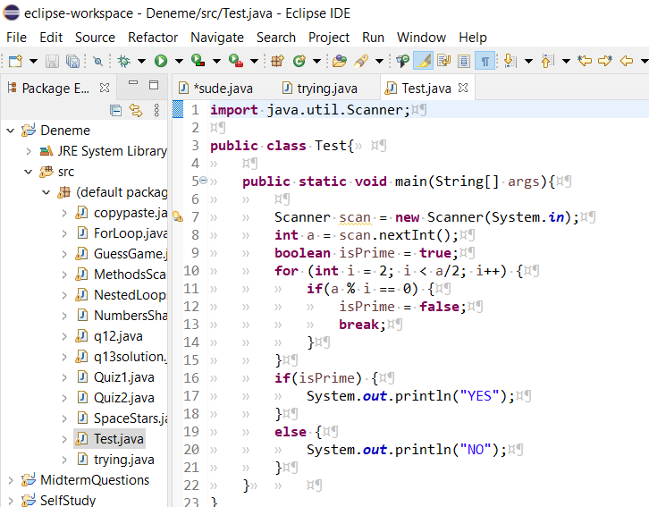
Some Alternatives

Slide 21

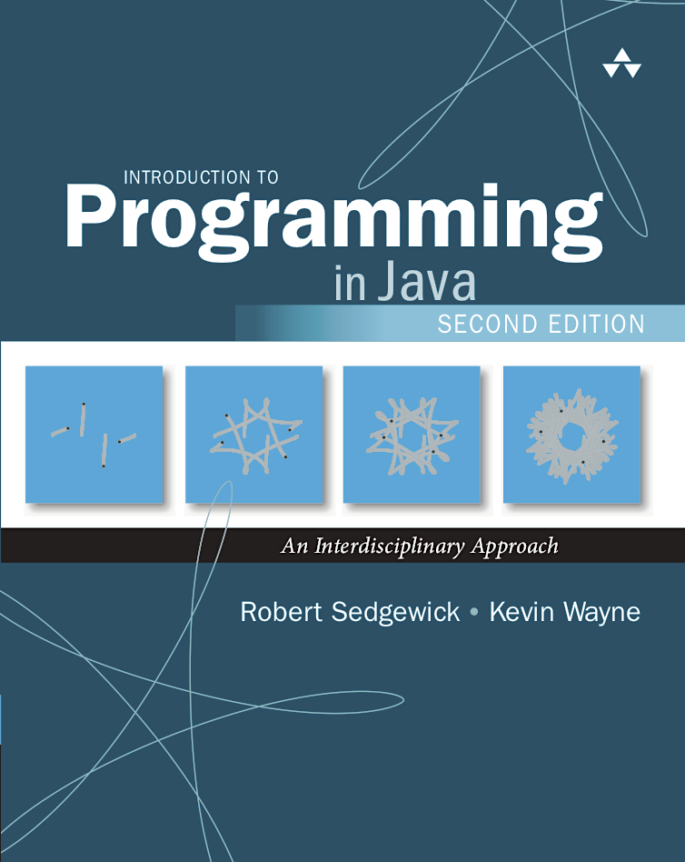
Our Book
https://introcs.cs.princeton.edu/java/home/
Where comprehension quizzes and assignments will come from.
An extra resource for each of these topics.

Slide 22
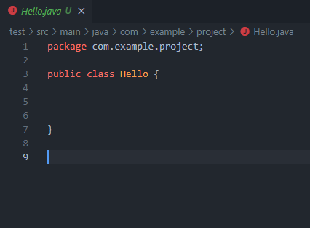
File Creation
Needs the Extension .java

Slide 23
File Creation
Needs the Extension .java
Depending on you editor and plugins may come with some boilerplate.

Slide 24
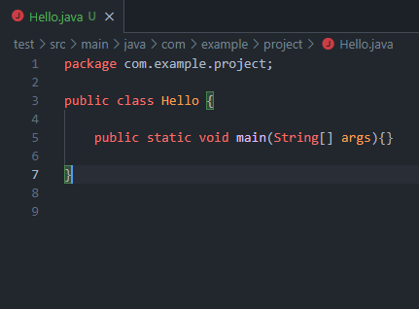
The Main Method
Named as such because of the name of the method.

Slide 25
The Main Method
Named as such because of the name of the method.

Slide 26
The Main Method
Named as such because of the name of the method.
Every program requires a main method.

Slide 27
The Main Method
Named as such because of the name of the method.
Every program requires a main method.
Also, a part of the java boilerplate.

Slide 28
The Main Method: Anatomy
public - access modifier

Slide 29
The Main Method: Anatomy
public - access modifier
static - non-access modifier

Slide 30
The Main Method: Anatomy
public - access modifier
static - non-access modifier
void - return type

Slide 31
The Main Method: Anatomy
public - access modifier
static - non-access modifier
void - return type
main - method name

Slide 32
The Main Method: Anatomy
public - access modifier
static - non-access modifier
void - return type
main - method name
String[ ] - the expected argument type

Slide 33
The Main Method: Anatomy
public - access modifier
static - non-access modifier
void - return type
main - method name
String[ ] - the expected argument
args - name of the argument

Slide 34
The Main Method: Anatomy
public - access modifier
static - non-access modifier
void - return type
main - method name
String[ ] - the expected argument
args - name of the argument

Slide 35
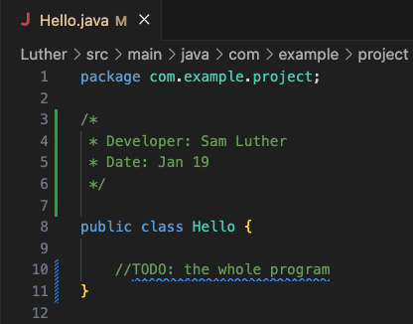
Java Comments
Comments in java can be represented in two ways.
Single-Line //some comment
Multi-Line
/*
Some comment
*/
In VSCode you can also create comment by highlighting an area and pressing (control + / ) or (command + / ) on mac.

Slide 36
A Quick Example

Slide 37
Daily Prompt
First lets step through the live share again.

Slide 38
Daily Prompt
Join the Link in Week 1

Slide 39
Daily Prompt
Join the Link in Week 1
I recommend doing it in the browser.

Slide 40
Daily Prompt
Join the Link in Week 1
I recommend doing it in the browser.
Navigate to my Hello.java file

Slide 41
Daily Prompt
Join the Link in Week 1
I recommend doing it in the browser.
Navigate to my Hello.java file
Assignment:
Copy and paste the code from my file into the assignment on canvas.

Slide 42
Closing
Office Hours In SS-411:
Tu & Th 2pm – 3pm
Mon & Wed 10am–11am
Have a great first week and I’ll see you next Monday!

